Slide 1
THE SUSTAINABLE
CONSUMER
#SustainableConsumer
15 March
2020

Slide 2
15 March
What is world consumer rights day?
An annual occasion for celebration, impact and global solidarity within the international consumer movement.
Consumer organisations join together to highlight and raise awareness of an issue that is important to consumers around the world.
2020

Slide 3
Sustainable Consumption
Sustainable consumption aims to use the earth’s resources more efficiently and increase fair trade while helping to alleviate poverty and enable everyone to enjoy a good quality of life with access to food, water, energy, medicine and more.
We can make the transition to a more sustainable economic model in an equitable or inequitable way. We believe as well as safeguarding our essential natural resources, any transition also needs to deliver social justice and human rights.
The United Nations Guidelines for Consumer Protection, the blueprint for consumer rights were expanded significantly in 1999 to include a new section on sustainable consumption.

Slide 4
The Sustainable Consumer: About the Theme (1)
Millions are already feeling the effects of climate change.
Consumers have a vital role to play:
Firstly, through their purchasing power – a global study found that 66% of consumers say they’re willing to pay more for sustainable brands (a figure that rises to 73% for Millennials).
But also, through their ability to push for system change in supply chains or changes in regulation.

Slide 5
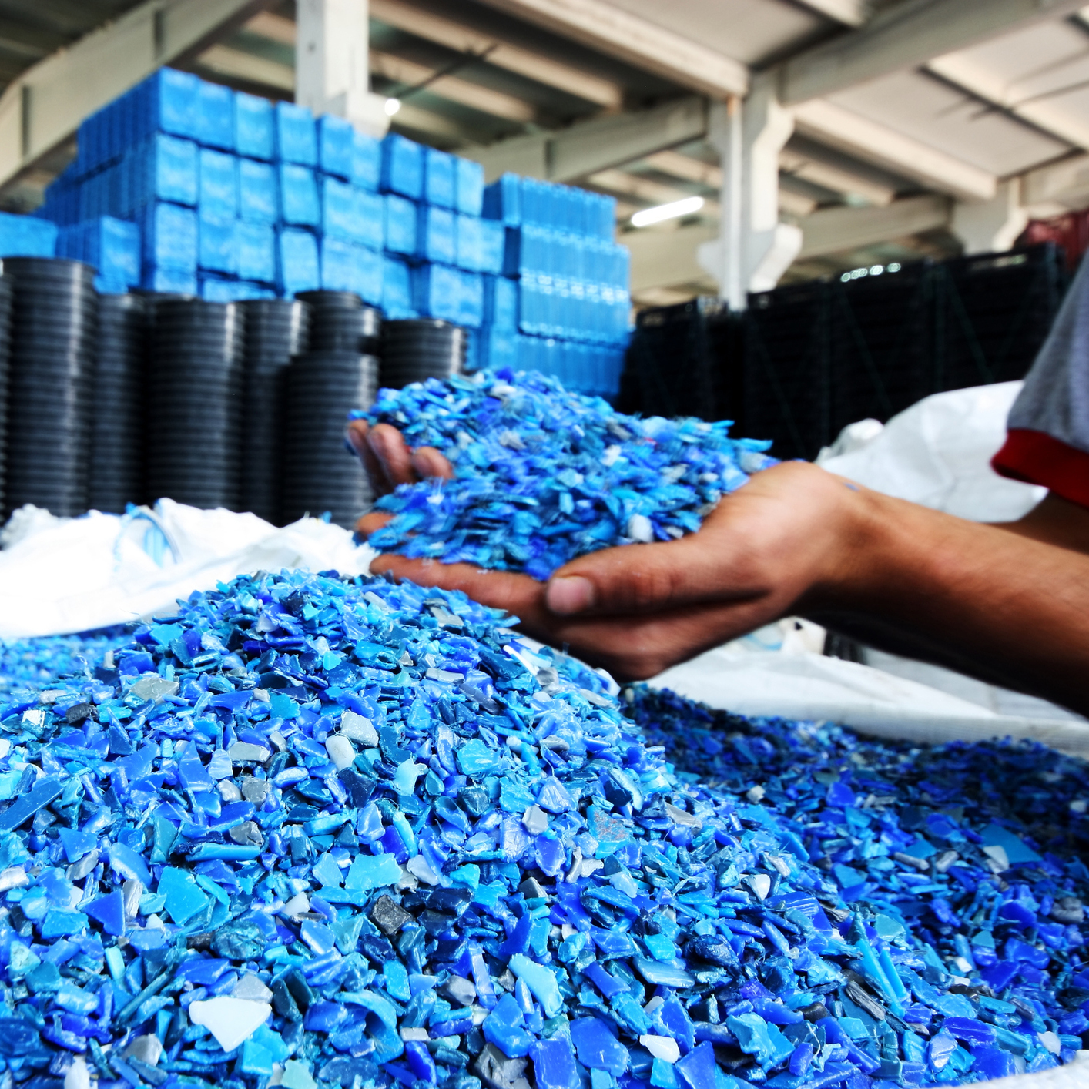
The Sustainable Consumer: About the Theme (2)
Consumers are already making changes to their lifestyle to be more sustainable – recycling, reducing food waste and avoiding unsustainable products, and they can make a bigger impact with further support from businesses and governments.
A recent survey found 37% don’t know how they can help tackle climate change and 59% feel they do not get enough support from governments, and 51% from business.
Governments and businesses must also act to give consumers the information, choice and the infrastructure they need to live more sustainable lives.

Slide 6
Consumers are critical
to the success of a transition towards more sustainable consumption, but they cannot do it alone.

Slide 7
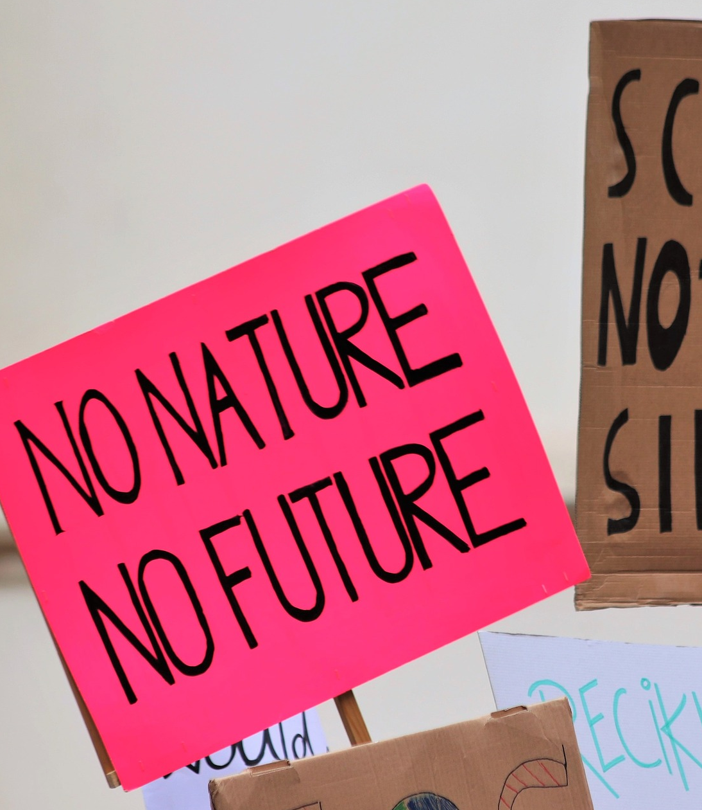
Gen Z - A Vital Generation
Young people are a key focus for World Consumer Rights Day. They are the face of climate activism – Greta Thunberg is 17-years-old, school children are striking against climate, Extinction Rebellion Youth protestors are in their teens and twenties.
Consumers International members will be going into schools, colleges and universities to talk to young people about sustainable consumption and ask them what they want to see from governments and businesses.

Slide 8
A survey of 10,000 people aged 18-25 in 22 countries around the world found that climate change was their most pressing concern
(Source: Amnesty)

Slide 9
What you can do
This World Consumer Rights Day is our chance to make the biggest impact possible. Climate change is a global challenge that requires coordinated and global solutions. Working together, our voices calling for change are far more powerful than they would be alone.
How to be part of the #SustainableConsumer campaign:
Plan activities for March 15, from awareness events in schools, stakeholder events and press briefings to advocacy campaigns targeting specific system changes.
Stay informed and be the first to receive campaign updates and resources in the run-up to March 15, by signing up for Consumers International’s email news services.
Connect with Consumers International on Twitter and Facebook for all the latest announcements about the day. Be part of the conversation on the day, and share your campaign updates or messages for change using #SustainableConsumer. You can also download free social media resources by following this link.

Slide 10
THANK YOU!

