Slide 1
Making digital marketplaces Fairer : Competition and choice in emerging digital markets
Notes:
Who has heard this phrase? Do you agree?
And what does it mean? Depends on who you ask….in this session I will talk about why it’s important as a digital issue and as a consumer issue
ISPs
Platforms
Consumer impact

Slide 2
Yemen and Morocco: only one ISP
Argentina 90% of broadband market is held by 3 companies
Brazil in some cities, a choice of only two providers
“We have 5 service providers, each has a poor service”
city of Gurgaon, India
Notes:
Comes up again and again
Healthy competition comes not only from the number of service providers, but also the availability, credibility and comparability of the information they provide to the market, and the ease with which consumers can switch providers.

Slide 3
Over half of all people in US get their news from either Twitter or Facebook
Pew 2015
1 in 2 global
internet users visit Amazon each month
Global Web Index 2016
Whatsapp top messenger in app in 109 countries
Global Web Index 2016
Notes:
FB Messenger is top messaging app in 49 countries
Over half of people in the US get news from either Twitter or Facebook, 2015 https://www.wired.com/2015/07/facebook-twitter-really-people-get-news/
Users of all genders, ages, races, demographics, education levels, and household incomes claimed they increasingly got their news on Facebook in 2015 compared to 2013, even as usage of these sites has remained pretty steady overall, according to Pew.
Not creating news but chanelling it such a rapid rate to attract attention that pushes stories to the extreme ends of public opinion in a way that wouldn’t have happened with traditional media. Raises question of responsibility:
"Never since the rise of the printing press have two companies held such a monopoly over the world’s information. Never have such organisations taken so little responsibility for it either," Jon Snow

Slide 4
Google’s share of desktop search traffic October 2017
BRAZIL
95%
INDIA
94%
GLOBAL
87%
NEXT BIGGEST
5%
Notes:
Others:
BING 5%
Yahoo 4%
BAIDU 1%

Slide 5
What’s the Consumer impact?
Large companies become default gateway to digital participation: indispensable, hard to walk away
Subject to cross selling and cross promotion of products
Choice editing – privacy tools disappear from certain app stores
Locked into ecosystem as products, services and data is not transferable to another place.
Notes:
The impact of a small number of dominant global companies on consumers, and a lack of choice of essential service providers has consumer impact:
consumers limited to one poor quality broadband service
subject to cross selling and cross promotion of products or
privacy tools disappearing from certain app stores.
The issue could quickly become more profound with the uptake of AI devices in the home or worn on the body combining with other services like shopping, directions and messaging. We are seeing two forces moving in opposite directions - less companies controlling more data derived from services and devices able to collect more granular data of different types, that continually learn, process and direct consumers choices.
This raises key questions of whether it is possible to hold such large companies with global reach to account, both as a regulatory body and as an individual. Authorities are working in pre-digital economy conceptual frameworks, and as a consumer if you don’t like the way a company uses your information it is not always possible to walk away from a service that has become an indispensable default.

Slide 6
What’s the Consumer impact?
Future? Uptake of AI devices in the home or worn on the body combining with other services like shopping, directions and messaging.
Is it possible to hold such large companies with global reach to account, both as a regulatory body and as an individual?
What are alternative approaches to get the best outcomes for consumers?
Notes:
The impact of a small number of dominant global companies on consumers, and a lack of choice of essential service providers has consumer impact:
consumers limited to one poor quality broadband service
subject to cross selling and cross promotion of products or
privacy tools disappearing from certain app stores.
The issue could quickly become more profound with the uptake of AI devices in the home or worn on the body combining with other services like shopping, directions and messaging. We are seeing two forces moving in opposite directions - less companies controlling more data derived from services and devices able to collect more granular data of different types, that continually learn, process and direct consumers choices.
This raises key questions of whether it is possible to hold such large companies with global reach to account, both as a regulatory body and as an individual. Authorities are working in pre-digital economy conceptual frameworks, and as a consumer if you don’t like the way a company uses your information it is not always possible to walk away from a service that has become an indispensable default.

Slide 7
You can have any colour you like as long as it’s from Amazon….?

Slide 8
Challenging assumptions
Self-correcting market concentration?
“#
”Bright new avatars of innovation or sinister new centres of unaccountable power?”
Buzzfeed, 2017
Notes:
Self correcting market concentration: idea that flaccid incumbents will be destroyed by smaller, leaner ones, as has happened in the past. Rests on idea that size isn’t inevitably an advantage as it stops innovation/productivity at some point.
Not so much the case w digital concentration:
The best start-ups keep being scooped up by the big guys, like Instagram and WhatsApp, now owned by Facebook) and countless others that you haven’t heard of
Those not bought face high competition and difficult conditions
their innovations copied maybe, eg Snapchat ‘stories’ to Insta
created an ecosystem that enriches themselves even when they don’t think of the best ideas first, they run server clouds, app stores, ad networks and control search – all of the things that smaller companies NEED to flourish
So many question idea that just as they made best use of tech and invention to develop new services and disrupts markets, so will others.
Another big reason behind this is that: high-tech companies grow more useful to customers when they attract more users and when they gather ever more data about those users… what’s known as the NETWORK effect

Slide 9
Network effect
The more participants, the more connections, the more content, the richer the experience.
Harder to shift over to another offer – requires an alternative viable network to make it worthwhile
Notes:
Talk about network effect. Of course, always had it, the term was coined at dawn of mass uptake of telephone system.
But other settings like telecoms are heavily regulated.

Slide 10
Responses
Redefining market power
OECD
A company might buy up a rival just to get hold of its data… exploring looking at mergers with valuable data involved
EC, 2016
Test case on the data sources that the biggest search engines use to make recommendations
Brazil, 2018
Redefining consumer welfare
BEUC
Notes:
Central issue is of how regulatory frameworks to protect consumers from harm and promote wellbeing and value can be repurposed to respond effectively to the speed and scale of change that the network effects of digital companies can bring.
Introduce a new angle to expand the debate:
All of these multiple issues would benefit from putting the consumer experience of digital technology and markets at the centre of problem solving. This would unlock a much more diverse range of options and a greater understanding of the issues and be a focal point around which to convene a diverse range of stakeholders.
This sounds obvious, but to date the existing policy and enforcement split between consumer protection, data protection and competition law has meant the full impact and experience of consumers in the digital economy and society is not always aligned with competition authorities’ other considerations.
Understanding the consumer perspective of lock-in: understanding what the network effect feels to a consumer in a social network, or as part of a tech company’s ecosystem can help make interoperability initiatives more effective, by focusing not just on the required technical specifications but on the behaviours that large companies use to entice and keep customers.
Getting started…
We would initially convene competition authorities, consumer protection agencies, incumbent businesses, sectoral regulators with experience of addressing dominance issues (eg Airlines, Banking), standards setters such as the ITU and IETF, behavioural experts who understand the impact of lock in as well as the designers of those systems and can understand how to offset the effects, digital rights and civil rights organisations concerned with particular aspects of competition eg Net Neutrality and its importance to maintaining choice and freedom.

Slide 11
Consumers International Recommendations
Meaningful choice of digital providers, products and services
Essential nature of being online
Limited ability to switch due to lock in
Rights to port data and interoperable services
Notes:
The impact of a small number of dominant global companies on consumers, and a lack of choice of essential service providers has consumer impact:
consumers limited to one poor quality broadband service
subject to cross selling and cross promotion of products or
privacy tools disappearing from certain app stores.
The issue could quickly become more profound with the uptake of AI devices in the home or worn on the body combining with other services like shopping, directions and messaging. We are seeing two forces moving in opposite directions - less companies controlling more data derived from services and devices able to collect more granular data of different types, that continually learn, process and direct consumers choices.
This raises key questions of whether it is possible to hold such large companies with global reach to account, both as a regulatory body and as an individual. Authorities are working in pre-digital economy conceptual frameworks, and as a consumer if you don’t like the way a company uses your information it is not always possible to walk away from a service that has become an indispensable default.

Slide 12
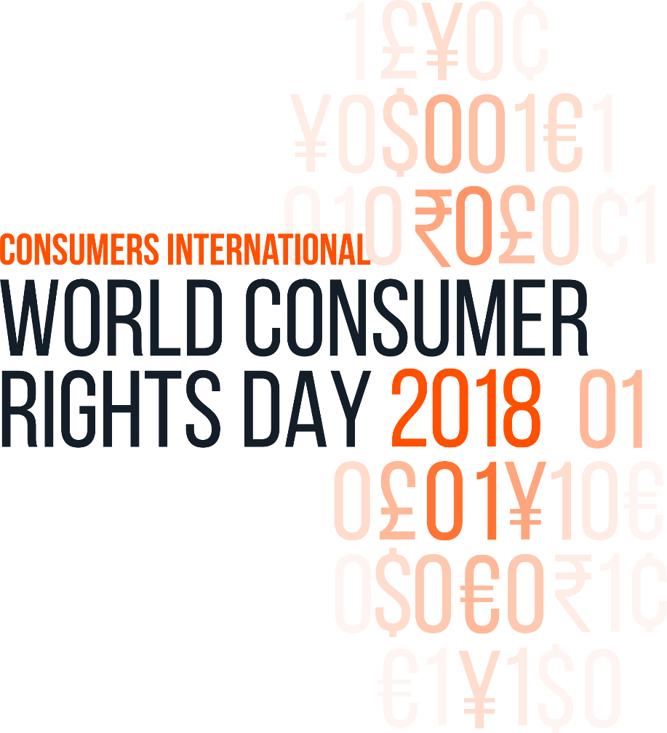
#betterdigitalworld

