Slide 1
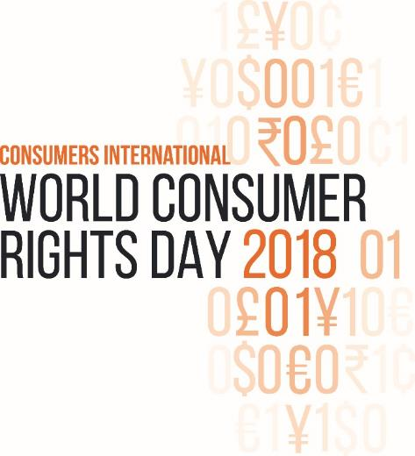
World Consumer Rights Day 2018
Making Digital Marketplaces Fairer
#BetterDigitalWorld
15 March 2018
Notes:
Unless otherwise specified, sources for the information quoted here can be found in the briefings produced by Consumers International for World Consumer Rights Day 2018.

Slide 2
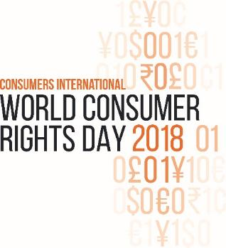
What is world consumer rights day?
An annual occasion for celebration, impact and global solidarity within the international consumer movement.
Consumer organisations join together to highlight and raise awareness of an issue that is important to consumers around the world.
page

Slide 3
MAKING DIGITAL MARKETPLACES FAIRER
E-commerce has opened up a vast array of choice for consumers, enabling them to shape markets in new ways.
However, there are important questions that need to be addressed:
How can we establish access to fair and secure markets for everyone?
How can we protect consumers from online scams?
How can we prevent unfair business practices and ensure redress is available when things go wrong?

Slide 4
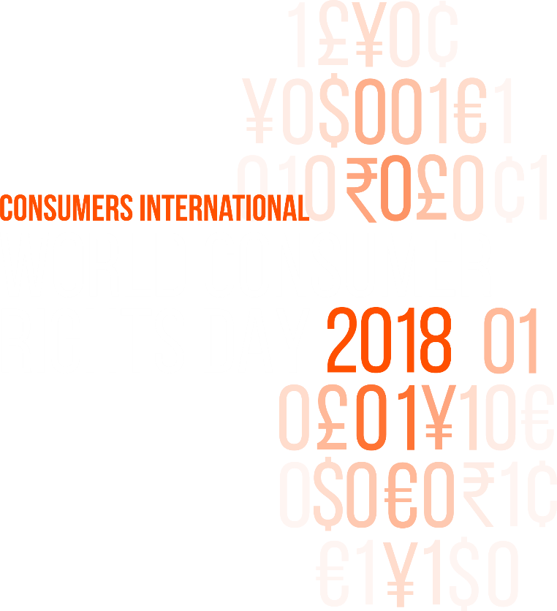
What are we calling for?
ACCESS TO FAIR AND SECURE INTERNET SERVICES
BETTER PROTECTION ONLINE
ACTION AGAINST SCAMS AND FRAUD

Slide 5
1. Access and choice
Half the world’s population is still offline, preventing access to digital markets
Some internet service providers use practices such as data capping to limit access unfairly.
Consumers should have access to affordable, good quality and open internet services.
page

Slide 6
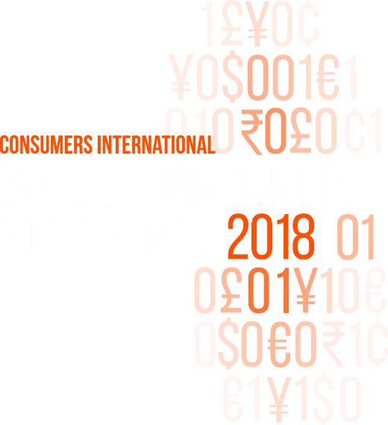
Between 2013 and 2015, A 1GB broadband plan would have cost an average African citizen 18% of their monthly income
Notes:
Source: ‘Connecting Voices: A Role for Consumer Rights in Developing Digital Society’, Consumers International, 2017, p. 18

Slide 7
2. SCAMS
Half of people who never shop online blame a lack of trust
Scammers can pretend to be legitimate sellers, place fake adverts on legitimate platforms or engage in payment fraud.
Platforms should make it as easy as possible to report and block fraudulent ads, while governments should ensure that digital consumer protection is an integral part of the regulatory framework.

Slide 8
The number of fraud cases globally has increased by 19% compared to 2013. FOR EVERY $100 IN TURNOVER, FRAUDSTERS CURRENTLY TAKE 5.65 CENTS.

Slide 9
3.1 Better protection online: Fairer business practices
Fear of unfair, unclear and confusing business practices can damage consumer trust in e-commerce
Some online retailers use techniques such as drip pricing and price discrimination to charge consumers unfairly.
Digital providers should follow UN Guidelines for Consumer Protection best practice, and consumer protection frameworks should meet UN requirements.

Slide 10
In 2017, EU research found that 67% of price comparison websites were misleading users

Slide 11
3.2 Better protection online: REDress
Consumers need to know that problems with online shopping can be easily sorted out.
Consumers’ access to redress can vary a lot by region or country
Even when consumers have the right to redress, they don’t always know it. A 2015 EU survey showed that most consumers shopping online were unaware of their rights.
Online retailers need strong internal dispute mechanisms that are easy to understand, while regulators should work across jurisdictions to support cross-border dispute resolution.

Slide 12
less than 10%
of consumers international members from Africa and Latin America and the Caribbean say that consumers have regular access to redress

Slide 13
What you can do
Consumers International members can choose to take action on the issues in e-commerce that are most relevant in their own countries
In the past members have held events, engaged with their local media, produced reports, advocated to national governments, targeted companies and held conversations with consumers
Consumers International will bring together activities from around the world on our website, showcasing our collective voice
Share your action with the hashtag #BetterDigitalWorld to build the international picture.

